Slide 1

Project Title -Healthcare Analytics for Doctor Visits TIRTC
Submitted by : Gautham Krishna G
Sree Buddha College of Engineering, Pattoor
AICTE STU ID : STU6a68c4627a09d1785250914

Slide 2

PROBLEM STATEMENT
Healthcare providers and insurers need to understand what actually drives people to visit the doctor — is it income, illness severity, chronic conditions, or insurance coverage? This project analyzes patient-level health survey data to uncover which factors are linked to higher doctor visit frequency, and how illness impact differs across gender and income groups.

Slide 3
Project Description
This project uses a healthcare survey dataset of 5,190 patients covering doctor visits, illness count, income, gender, age, insurance type, and chronic conditions. The analysis includes data cleaning, exploratory data analysis, and visualizations built in Python to identify patterns — for example, how reduced-activity days correlate with visit frequency, how chronic illness affects visit counts, and how insurance coverage is distributed across the population. The goal is to turn raw survey data into insights that could support healthcare planning and resource allocation.

Slide 4

WHO ARE THE END USERS?
Healthcare policy analysts and insurance providers who need to understand patient behavior patterns; hospital administrators planning for patient load and outreach; and public health researchers studying how income and insurance access affect healthcare utilization.

Slide 5

Technology Used
Python
Pandas
NumPy
Matplotlib
Seaborn
Google Colab (Jupyter Notebook environment)

Slide 6
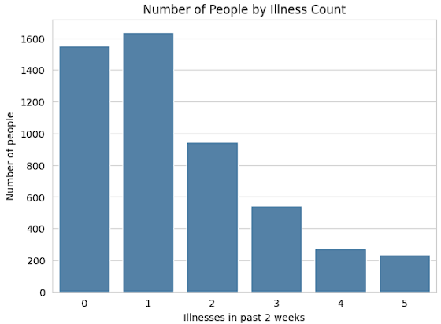
RESULTS

Slide 7
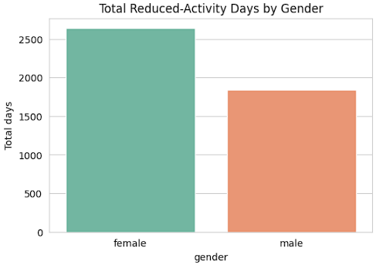
RESULTS

Slide 8
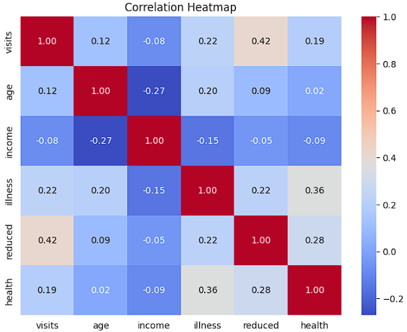
RESULTS

Slide 9
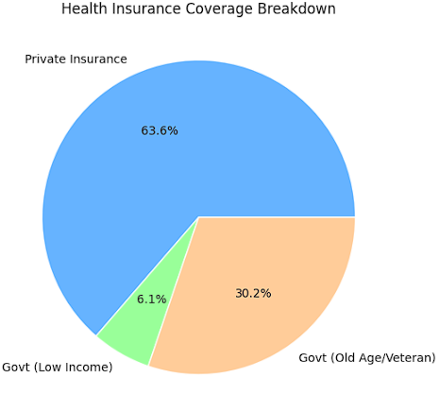
RESULTS

Slide 10
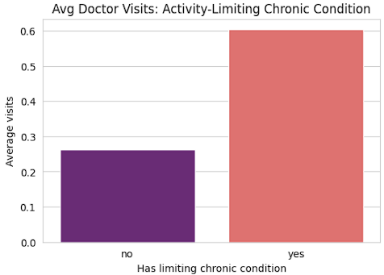
RESULTS

Slide 11
GITHUB LINK
https://github.com/GauthamKrishna42/Healthcare_Analytics_for_Doctor_Visits.git

Slide 12
Thank you

